Slide 1

NAME : RAVI KISHORE
REG.NO : 12218701
ROLL NO : 27

Slide 2
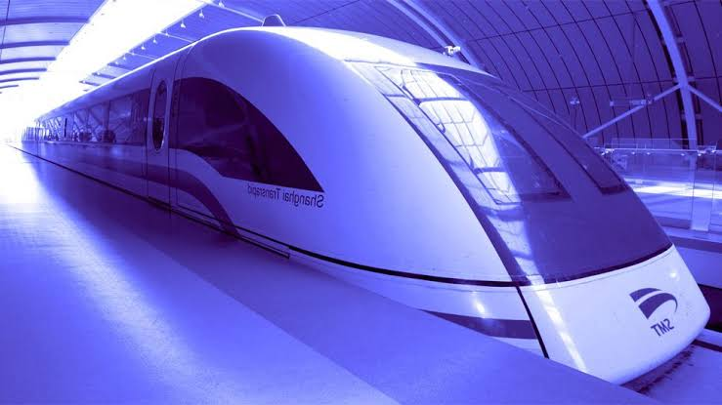
MAGLEV

Slide 3
THE TECHNOLOGY
There are two primary types of maglev technology:
    Electro Magnetic Suspension
    Electro Dynamic Suspension
Two other types of technologies are studied
    Indutruck
    MDS

Slide 4

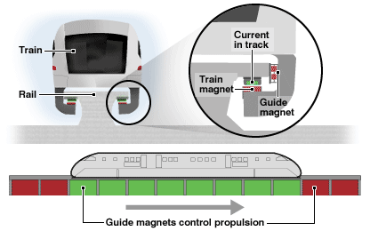
Principle : uses the attractive magnetic force of a magnet beneath a rail to lift the train up

Slide 5

Advantages
Low magnetic field inside and outside the vehicle
Commercially available
No secondary propulsion system needed
Dis-Advantages
The system needs to be monitored by outside system to maintain the distance between the Track and the train
Vibraitions may occur due to instability and outside monitoring.

Slide 6

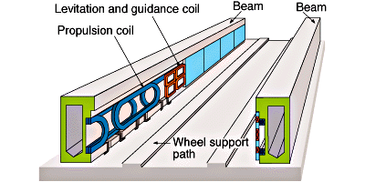
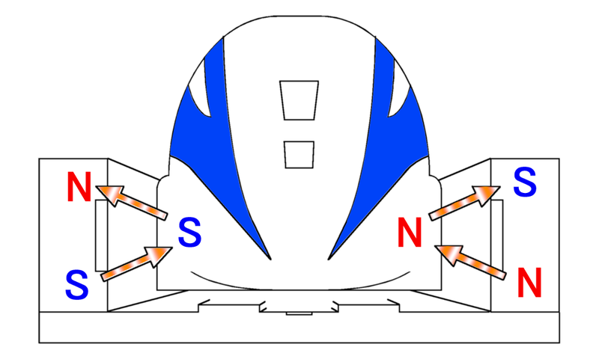
Principle: uses a repulsive force between two magnetic fields to push the train away from the rail

Slide 7

Advantages
highest speed (581 km/h)
Heavy load capacity
Dis-Advantages
Limited guideway conductivity (limit’s speed)
Necessary use of magneting shielding due to the strong magnetic fields
The vehicule must be wheeled to travel at low speed

Slide 8

Principle : Same system as the EDS, but the track is made of permanent magnets. Magnetic field placed under the train.
+++
No power required to activate the magnets
Can levitate at low speed (5km/h)
Lower Costs
Cars slow down on their own
---
Wheels needed at slow speed

Slide 9

Principle : Same system as the EMS, but the track is made of permanent magnets. Railwail must be built so that the train uses gravity to go forward.
No power required to activate the magnets
No outside monitoring of the space between the
Attrative force is stronger than repulsive force
Cars slow down on their own
system based on physics and mathematic calculations.
Wheels needed at low speed
guideway must be made to exact specifications and is very expensive
Exists only on paper

Slide 10

1971: West Germany (90 kmph)
1972 : Japan (60 kmph)
1975 : West Germany (401.3 kmph)
1979 : Japan (517 kmph)

Slide 11

German Maglev company
Japan Railway company
French TGV
New countries are entered in competition

Slide 12

Prices are decreasing (to 50 yuan from 75)
Costs ($ 1,2 billions)

Slide 13
THANK YOU

